Slide 1
California Fire Crisis: Where to Start
Tim Enfield
April 2020
MSBA Practicum
Notes:
Between 1992 and 2015, fire prevention campaigns help decrease the number of annual fires but average fire size has overall increased. Back in 1992, 9076 fires sparked on average 33 acres each. In 2015, the raw numbers of fires decreased to about 5500, but with average size of 150 acres each. To compound the issue, the most destructive and largest fires, those over 1000 acres, have increased 100-200% over those 25 years.
I was contacted to explore this further on your team’s behalf and come up with a plan of attack to alleviate this crisis, but the truth is, with some many factors, the right question is just “where should we start?

Slide 2
Nobody can solve the California fire crisis over just 3 weeks.
Designed as exploratory analysis only, to provide lens into:
High Level understanding of what is going on
Trends
Leading indicators
Weather
Prevention
Efforts
Causes
Size/
Quantity
Duration
Season
??
Leading
Indicators
Timing
Destruction
Historical
Trends
THE PUZZLE
COLLISION
CAUSES
DROUGHT IMPACT
SUMMARY/ Q&A
Notes:
Why? Because in the limited time horizon is just too short to solve the California fire situation. Instead we have framed this conversation as an exploratory analysis design, providing a lens into a high-level baseline understanding, some trends, and perhaps uncover some leading indicators. Our goal here is simply to discover the missing puzzle pieces you will need take this futher.

Slide 3
Core Business Question
What are a few key new areas of inquiry that can explore the progress and shortfalls of the past 20 years traditional fire safety and most importantly, lead to possible next steps?
THE PUZZLE
COLLISION
CAUSES
DROUGHT IMPACT
SUMMARY/ Q&A
Notes:
What are a few key new areas of inquiry that can explore the progress and shortfalls of the past 20 years traditional fire safety and most importantly, lead to possible next steps?
To help explore this question, we looked at 24 years of public georeferenced US Wildfire data originally generated to support the national Fire Program Analysis (FPA) system. This amounted to 189,550 individual California fire data ranging from 1992-2015, incorporating 51 multidimensional attributes (geography, size, owner, duration, cause etc.)

Slide 4
Exploratory Analysis gives four key takeaways
Over the past 20 years, the fire danger and populous California communities are colliding.
Lightning is by far the largest reason for big fires and man-made reasons have greatly declined.
A huge number of fires are now without an official cause.
Drought years seem to have fewer, more destructive fires, while there seems to be a four-year cycle with fire seasons. (El Nino/La Nina?)
THE PUZZLE
COLLISION
CAUSES
DROUGHT IMPACT
SUMMARY/ Q&A

Slide 5
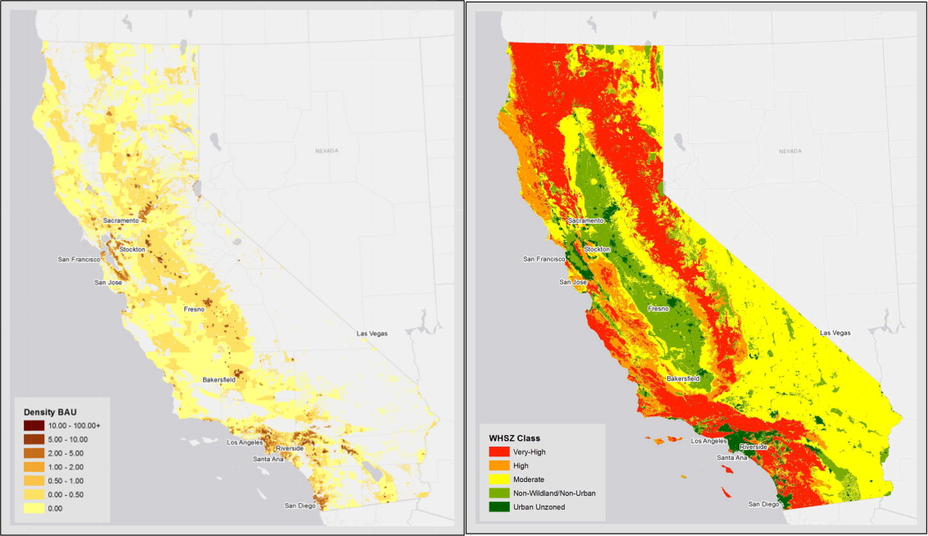
2008-2015 (Large Fires)
Recent years have seen danger from the largest fires inching closer and closer on the densest population regions.
Avg Large Fire: 12,100 acres
Annual Large Fires: 53 fires
At least 1000 acres, where darker is bigger fire
THE PUZZLE
COLLISION
CAUSES
DROUGHT IMPACT
SUMMARY/ Q&A
Notes:
The entire state is full of small brush fires, but California’s largest fires are concentrated in coastal and north/central areas. Over time, these fires have moved from the entire southern coast and Central Valley between 1992 and 1998, to more concentrated regional hotspots between 1999 and 2007, to finally more recently a huge concentration right through the middle of the state.
The largest category of fires, Type G, have doubled in size during that span from an average of 6000 to over 12000 acres.

Slide 6
Many of the preventable, directly human factors have greatly reduced fires, but lightning and brush fires are much more likely to cause big fires today.
Top 7 Causes | Small Fire, from 1992 to 2015* | Large Fire, from 1992 to 2015*
Equipment Use | -74% | -79%
Lightning | +45% | +215%
Arson | -13% | -87%
Debris Burning | +37% | +55%
Campfire | +16% | -37%
Children | -78% | -100%
Smoking | -74% | -80%
*as a % change based on 1992 levels
THE PUZZLE
COLLISION
CAUSES
DROUGHT IMPACT
SUMMARY/ Q&A
Notes:
Lightning, debris, and equipment are among the largest known causes in 2015. You’ll notice though that lightning caused large fires have doubled over 20 years, while forest fire prevention education must be working, with equipment fires, smoking, arson, and camping fires decreased substantially.

Slide 7
More may be done to gather to understand the 41% of fires whose reason is simply unknown or uncategorized, a trend that has been increasing since 1992.
 | 1992 | 2015
“Miscellaneous” | 25% | 20%
“Missing/Undefined” | 0% | 21%*
*In 2015, 90% small fires due to volume, but equally large/small as likely to be “missing”
THE PUZZLE
COLLISION
CAUSES
DROUGHT IMPACT
SUMMARY/ Q&A
Notes:
More may be done to gather to understand the 41% of fires whose reason is simply unknown or uncategorized, a trend that has been increasing since 1992. Interestingly in 2015, 90% of those missing causes were small fires due to volume, but equally large/small as likely to be “missing”

Slide 8
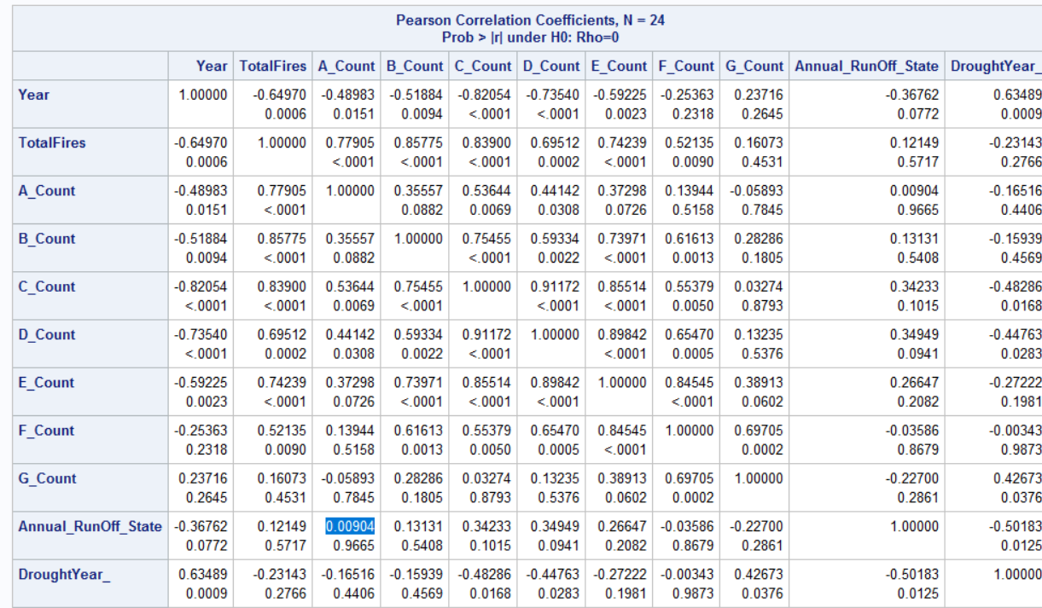
A drought year could mean less overall fires (fire ban/prevention?), but more huge fires.
THE PUZZLE
COLLISION
CAUSES
DROUGHT IMPACT
SUMMARY/ Q&A
Notes:
A drought year could mean less overall fires (fire ban/prevention?), but more huge fires.
While just merely directional feedback, additional rain runoff (ie a good snowy winter) surprisingly leads to more overall forest fires in the medium size but limits those massive destructive fires.
To help understand what next year’s fire danger might be, teams should look at both last year’s fire situation and the fire situation from around 4 years ago. The fire data seemed very cyclical.

Slide 9
So where does that leave us with the 4 key takeaways and areas of further inquiry?
Over the past 20 years, the fire danger and populous California communities are colliding.
Lightning is by far the largest reason for big fires and man-made reasons have greatly declined.
A huge number of fires are now without an official cause.
Drought years seem to have fewer, more destructive fires, while there seems to be a four-year cycle with fire seasons. (El Nino/La Nina?)
THE PUZZLE
COLLISION
CAUSES
DROUGHT IMPACT
SUMMARY/ Q&A

Slide 10
So where does that leave us with the 4 key takeaways and areas of further inquiry?
1. Over the past 20 years, the fire danger and populous California communities are colliding.
The areas that surround the central valley are often remote, dense forests and mountains, but they are the most important areas to protect—they have the largest fire risk.
THE PUZZLE
COLLISION
CAUSES
DROUGHT IMPACT
SUMMARY/ Q&A

Slide 11
So where does that leave us with the 4 key takeaways and areas of further inquiry?
2. Lightning is by far the largest reason for big fires and man-made reasons have greatly declined.
Ask and explore the question: “With the number of lightning fires increasing, what is the best way to limit what a lightning strike can spark?”
THE PUZZLE
COLLISION
CAUSES
DROUGHT IMPACT
SUMMARY/ Q&A

Slide 12
So where does that leave us with the 4 key takeaways and areas of further inquiry?
3. A huge number of fires are now without an official cause and without an official cause, less can be learned from each.
While this is a difficult one, there is a big gap in understanding fire causes. Are the small fires ok not to know causes? At what point in the investigation is it classified and accepted as “missing”? Some of these may have explainable causes and some remain unexplained.
This discrepancy is worth exploring to bring greater clarity to issue and enhance future fire prevention education and risk planning.
THE PUZZLE
COLLISION
CAUSES
DROUGHT IMPACT
SUMMARY/ Q&A

Slide 13
So where does that leave us with the 4 key takeaways and areas of further inquiry?
4. Drought years seem to have fewer, more destructive fires, while there seems to be a four-year cycle with fire seasons. (El Nino/La Nina?)
Weather cycles are known to be a contribution to the fire seasons, but perhaps using additional time series analysis and more input data, a quality model can be developed to predict when and where spending should be allocated throughout the state of California.
THE PUZZLE
COLLISION
CAUSES
DROUGHT IMPACT
SUMMARY/ Q&A

Slide 14
Q&A
THE PUZZLE
COLLISION
CAUSES
DROUGHT IMPACT
SUMMARY/ Q&A

Slide 15
Appendix

Slide 16
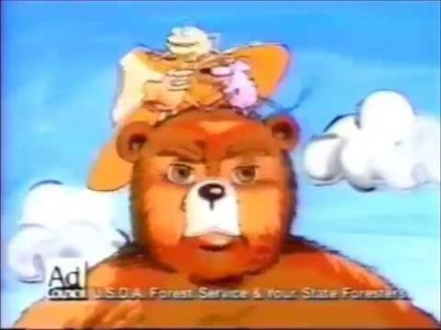
Notes:
With California’s

Slide 17
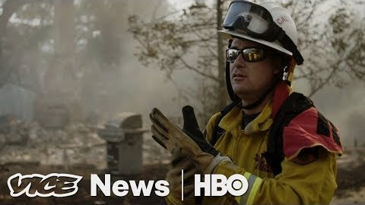
Notes:
With California’s

Slide 18
Between 1992 and 2015, the number of annual fires trended downwards but average fire size has overall increased.

Slide 19
Public Data Used:
24 years of georeferenced US Wildfire data originally generated to support the national Fire Program Analysis (FPA) system*
189,550 individual California fire data ranging from 1992-2015, incorporating 51 multidimensional attributes (geography, size, owner, duration, cause etc.)
Two data sets using SQL queries: individual fire data for geographical tracking and a year by year aggregated dataset for trend analysis
*Available via Kaggle SQLite database of 2.5 MM fires: https://www.kaggle.com/rtatman/188-million-us-wildfires

Slide 20
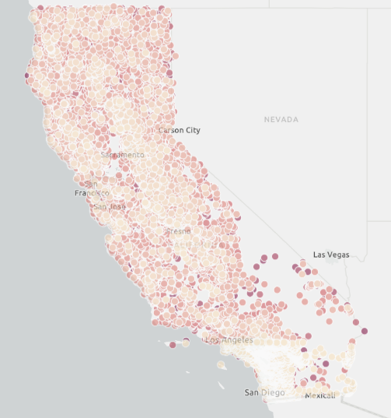
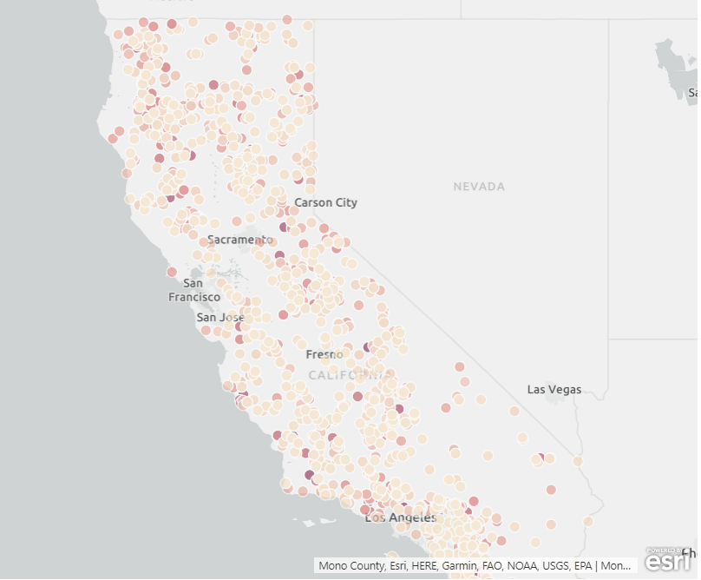
The entire state is full of small brush fires, but California’s largest fires are concentrated in coastal and north/central areas.
Brush fires (less than 10 acres)
Largest fires (at least 1000 acres)

Slide 21
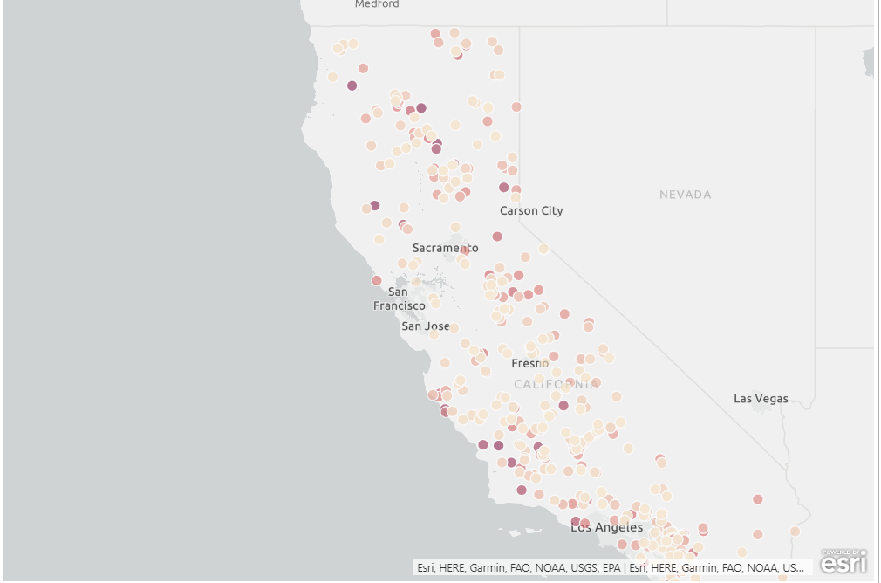
1992-1999 (Large Fires)
Over time, these fires have moved from the entire southern coast and Central Valley….
Avg Large Fire: 6,624 acres
Annual Large Fires: 50 fires
At least 1000 acres, where darker is bigger fire

Slide 22
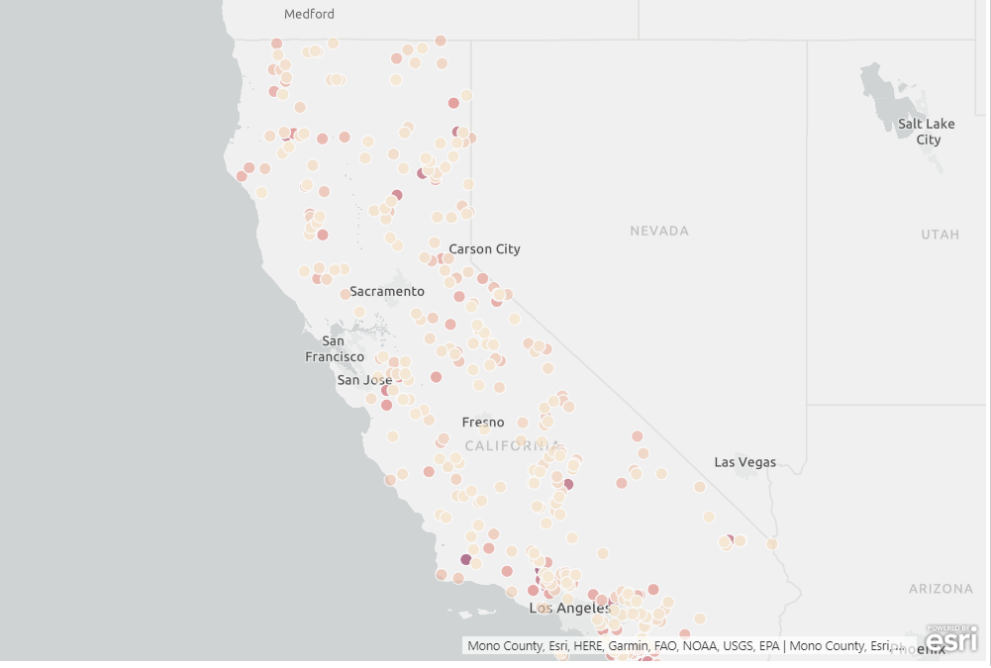
2000-2007 (Large Fires)
….to more concentrated regional hotspots….
Avg Large Fire: 11,141 acres
Annual Large Fires: 61 fires
At least 1000 acres, where darker is bigger fire

Slide 23
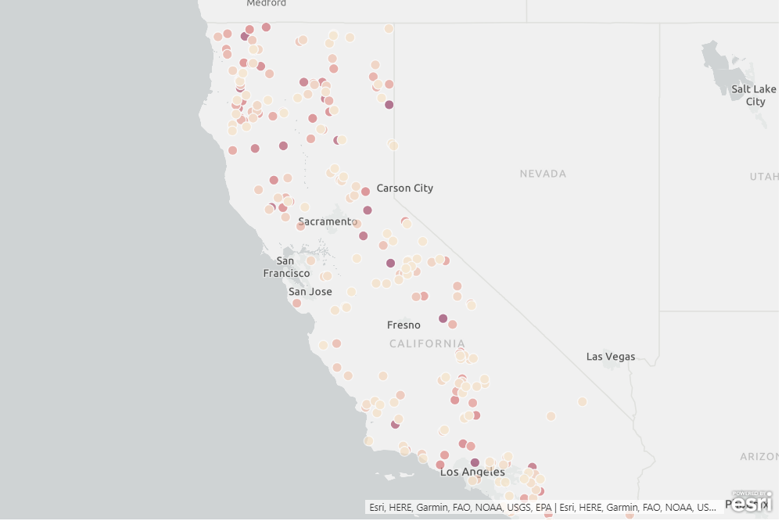
2008-2015 (Large Fires)
….to more recently a huge concentration right through the middle of the state.
Avg Large Fire: 12,100 acres
Annual Large Fires: 53 fires
At least 1000 acres, where darker is bigger fire

Slide 24
Lightning, debris, and equipment are among the largest known causes in 2015.
Small Fires
Large Fires

Slide 25
The July 4th and Labor day holidays are consistently, year over year the most common times for small fires.

Slide 26
With larger fires more often, a bad season can track to a single, unexpected abnormal day/week (think weather).
*The Northwest California Lightning Event of June 20-21, 2008 accounted for 68 (500+ total) large fires.
** Bark beetles hit 2003 California particularly tough, and in 2003, 389 on a single day of 9/3/03.

Slide 27
2015 Missing Causes, by Size
Category of Fire | Miscellaneous | Missing/Undefined
A- small | 22% | 17%
B-small | 26% | 23%
C-small | 26% | 23%
D | 28% | 21%
E | 17% | 21%
F-large | 38% | 33%
G-large | 4% | 11%

Slide 28
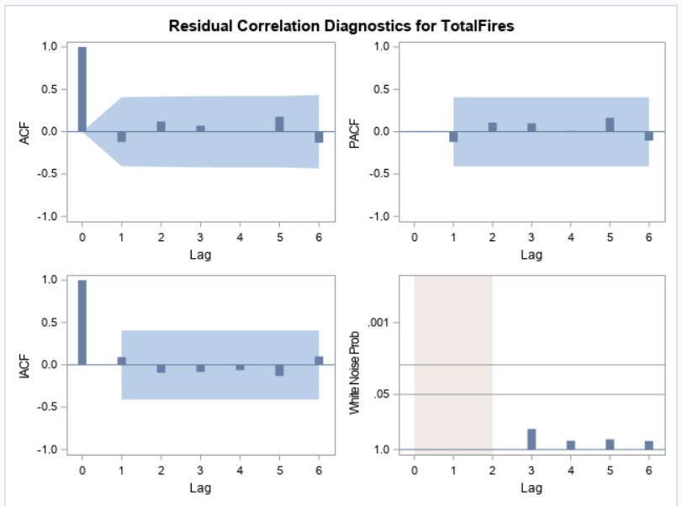
To help understand what next year’s fire danger might be, teams should look at both last year’s fire situation and the fire situation from around 4 years ago.
Initial TimeSeries Formula
1 –
0.38748 *(Last Year’s Fire Count) –
0.31774 B**(Fire Count from 4 years ago)
+ 7146.7 (Constant)
= Directional Estimation of Total Fire Count

